Slide 1
Case Index Number:
005
Posted by: | Injury | Technique
Ash Vasireddy (Consultant Orthopaedic Trauma Surgeon) Paul Harnett (Consultant Orthopaedic Trauma and Complex Hip Surgeon) King’s College Hospital, London, UK Original concept developed by Mr. Peter Bates, Royal London Hospital | Right anterior column posterior hemitransverse fracture | Acetabulum Open reduction and internal fixation via modified-Stoppa approach using the Starr Frame to lateralise the femoral head

Slide 2
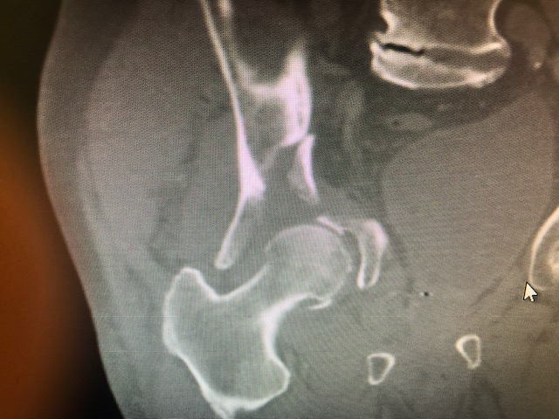
Elderly male with a complex anterior column posterior hemitransverse fracture.

Slide 3
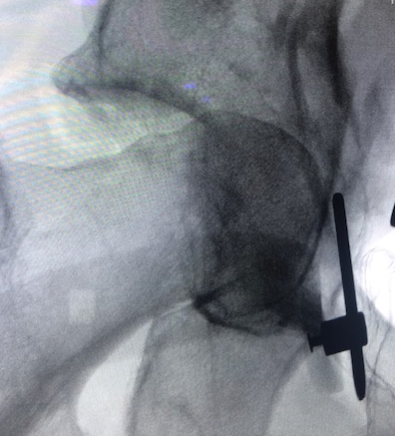

Slide 4
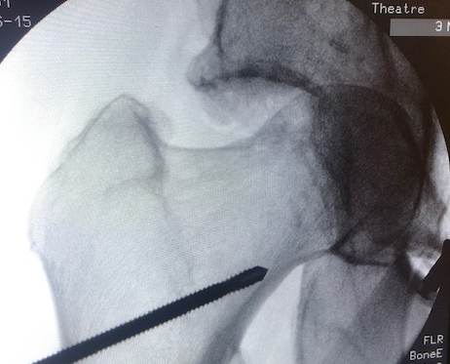
Schanz pin placed in the lower third of the femoral neck

Slide 5
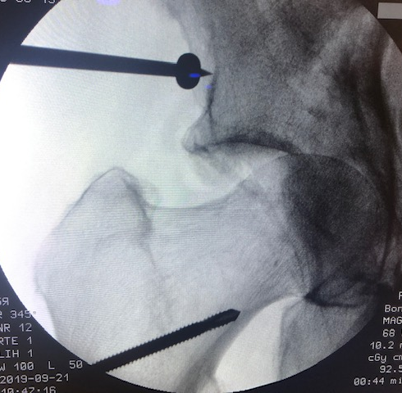
'Ball-spike’ pusher placed in the supraacetabular position to help stabilize the pelvis and right hip.
The ‘ball-spike’ pusher and schanz pins are now fixed to the Starr Frame via the driver attachments.

Slide 6
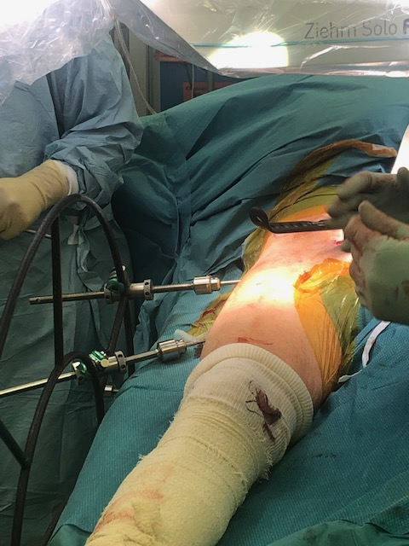
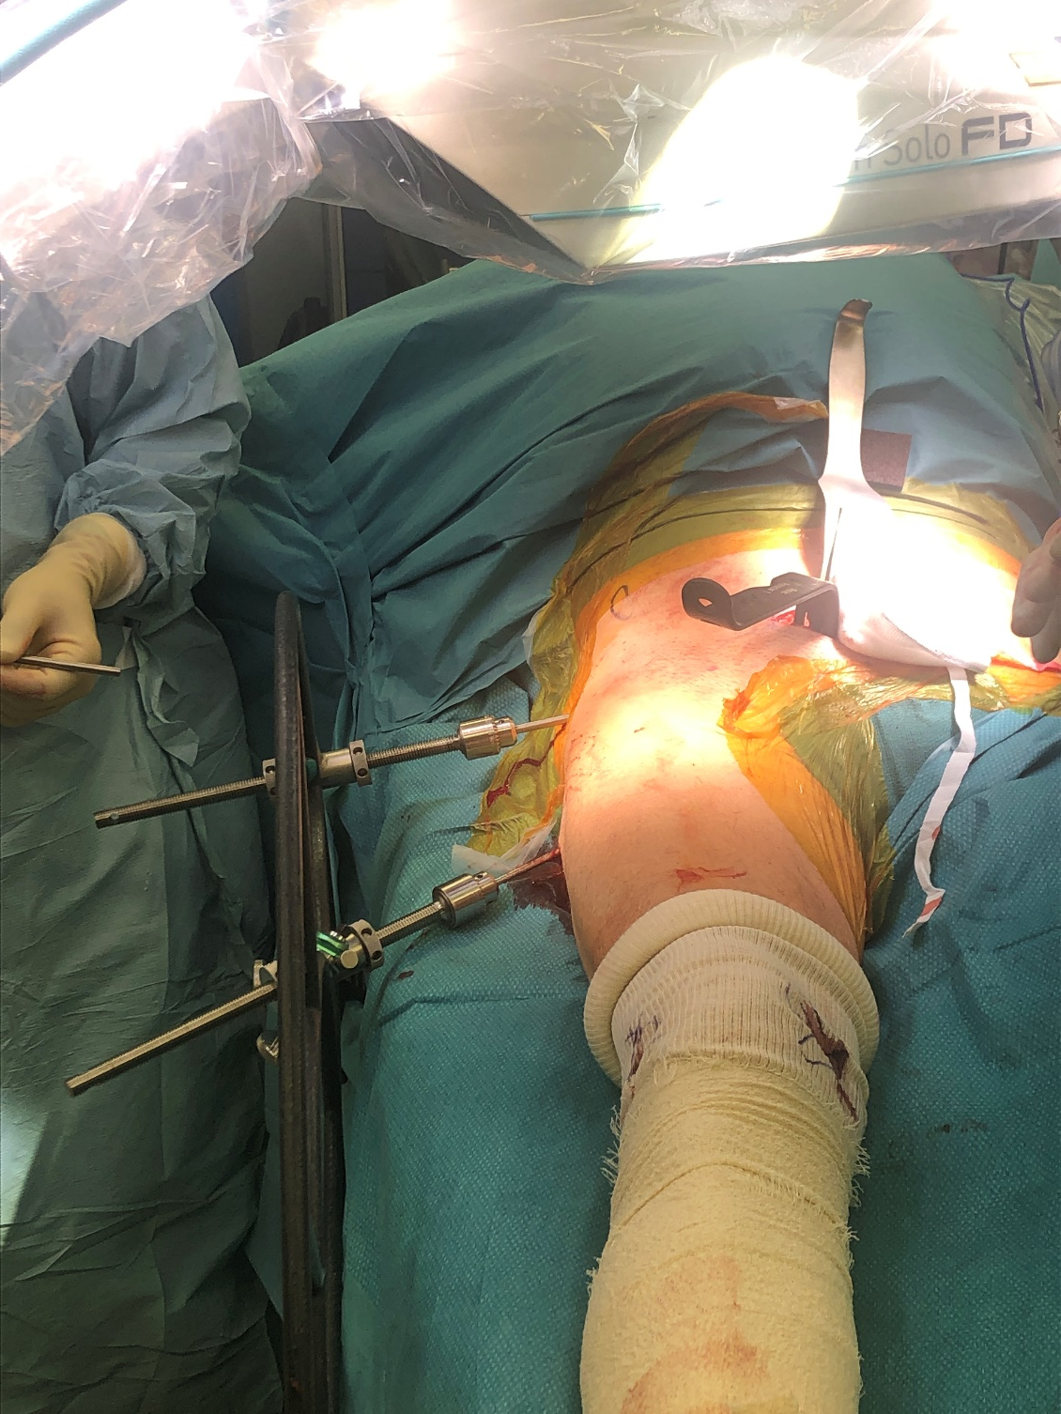
Clinical photographs highlighting how the Schanz pin and ‘ball-spike’ pusher are attached to the drive attachments, which are in turn attached to the Starr Frame.
We would recommend attaching the drivers to the Starr Frame once the ipsilateral knee is placed over a bump. This helps prevent stretching of the femoral neurovascular bundle prior to fracture reduction and insertion of implants.
The half Starr Frame can also be placed more caudal on the operating table. This provides space for an assistant to stand

Slide 7
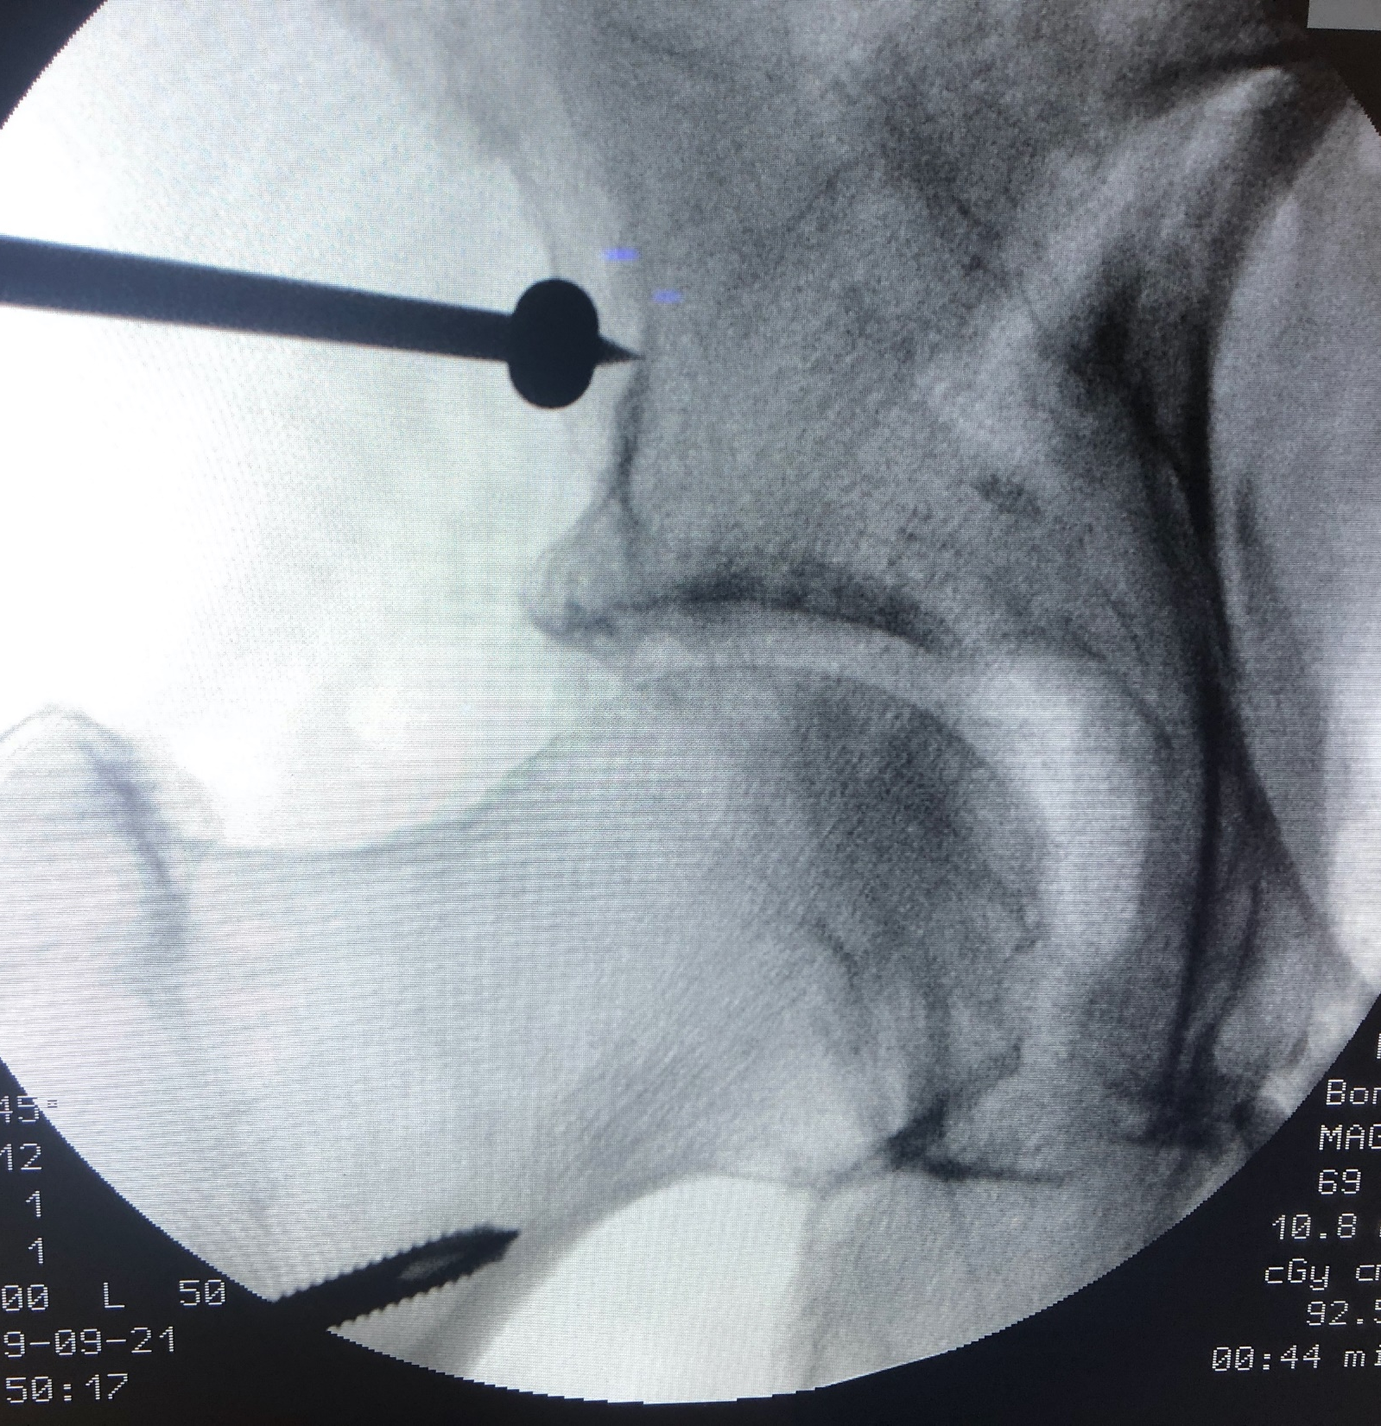
The driver, attached to the schanz pin, is then used to lateralise the femoral head and help reduce the fracture.
The fracture was then fixed and patient then went on to have a total hip replacement as part of a staged Fix & Replace strategy.

