Slide 1
Case Index Number:
003
Posted by: | Injury | Fixation
Adam Starr, M.D. Parkland Hospital Dallas, TX | Bilateral; SI joint disruptions; Rami fractures | IS screws; In-fix

Slide 2
Pelvic Fracture
40 year old male
6’2”, BMI approx 30
MVC
SBP 80mm Hg on arrival
ATLS
L side chest tube placed

Slide 3
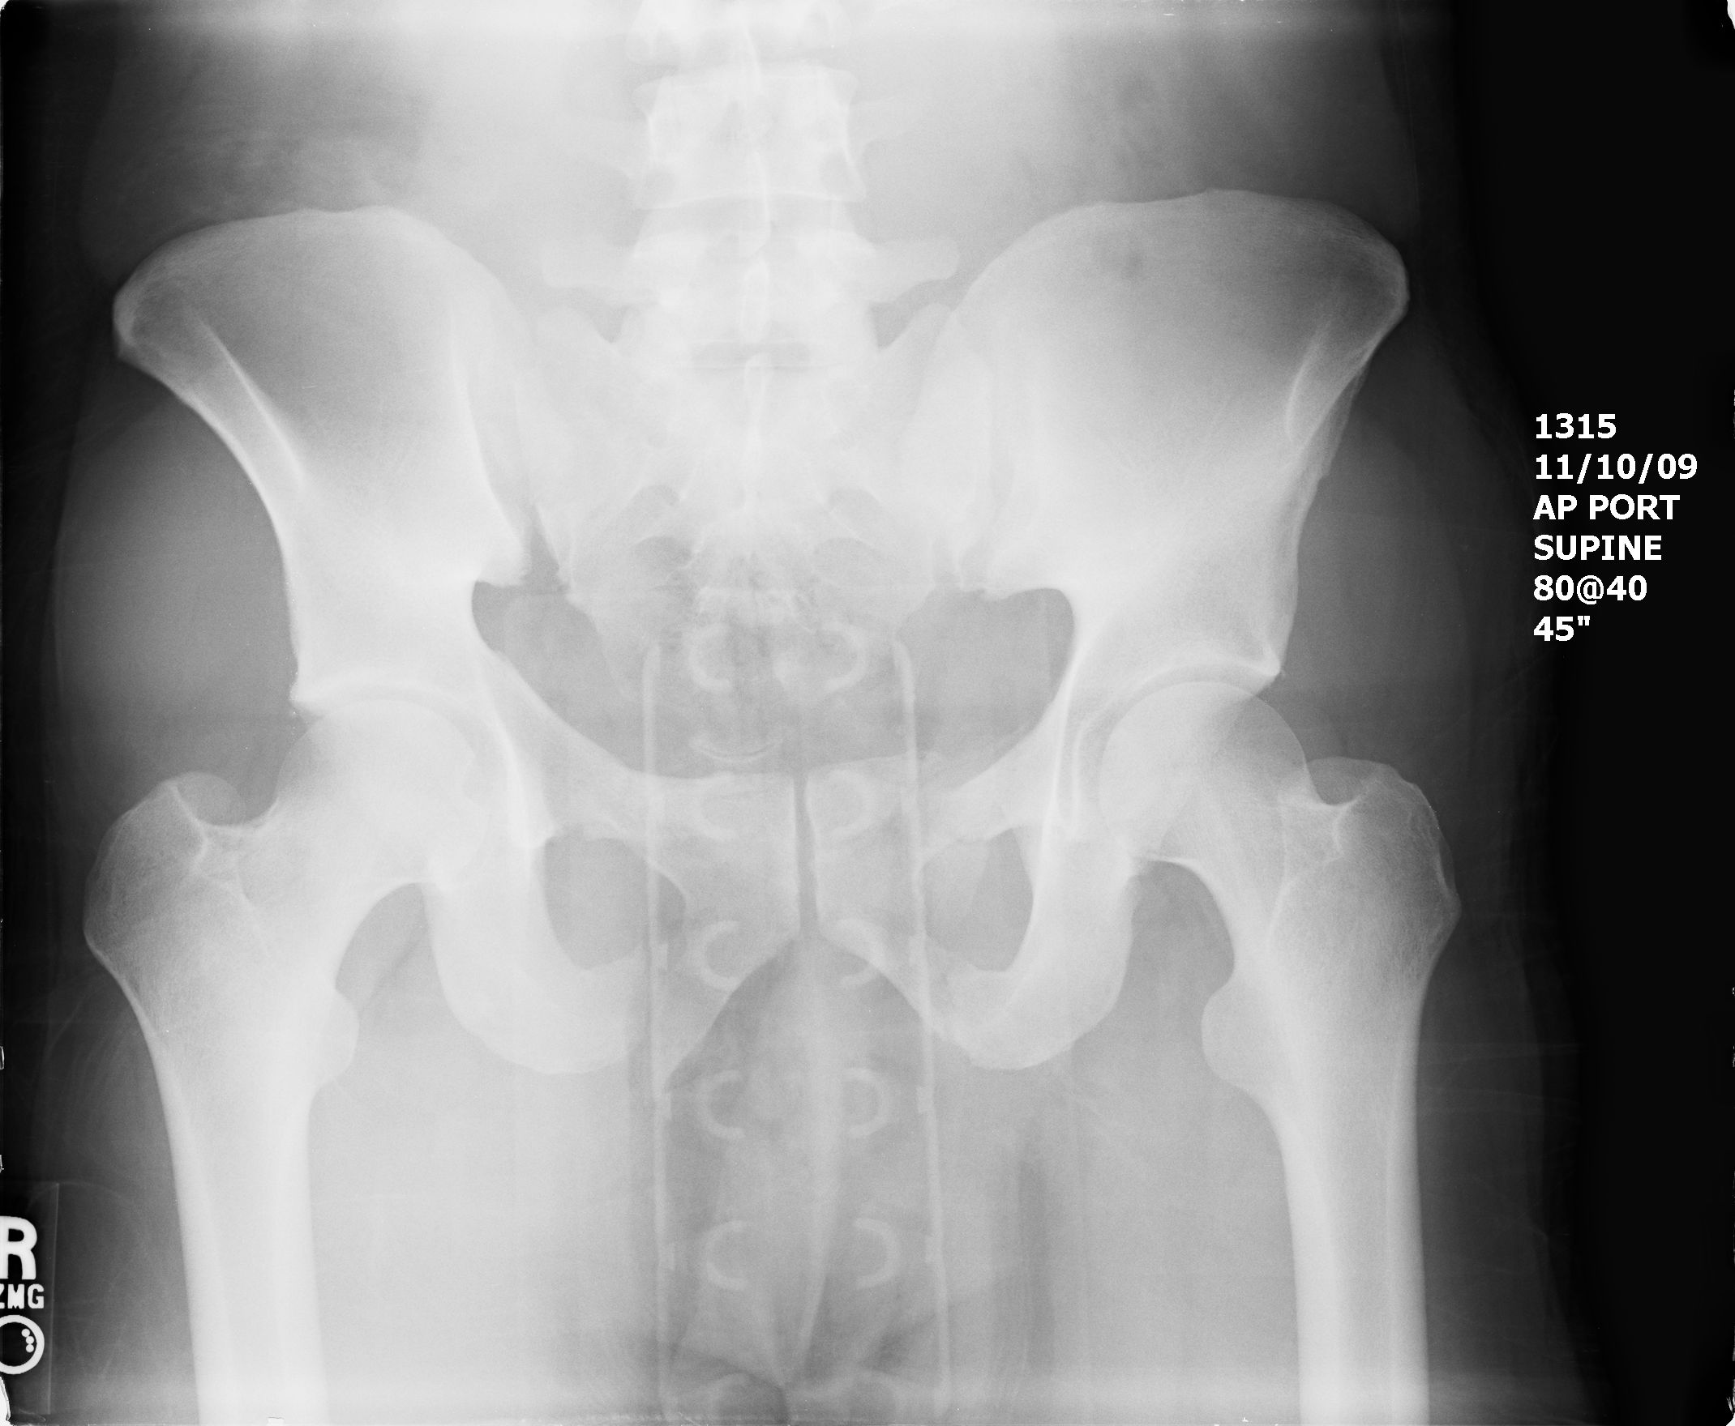

Slide 4
Pelvic Fracture
Taken for pelvic angiography
R sided obturator artery branch embolized
Undergoes R upper quadrant exploration for diaphragm repair
Post-operatively to SICU
Binder maintained in place

Slide 5
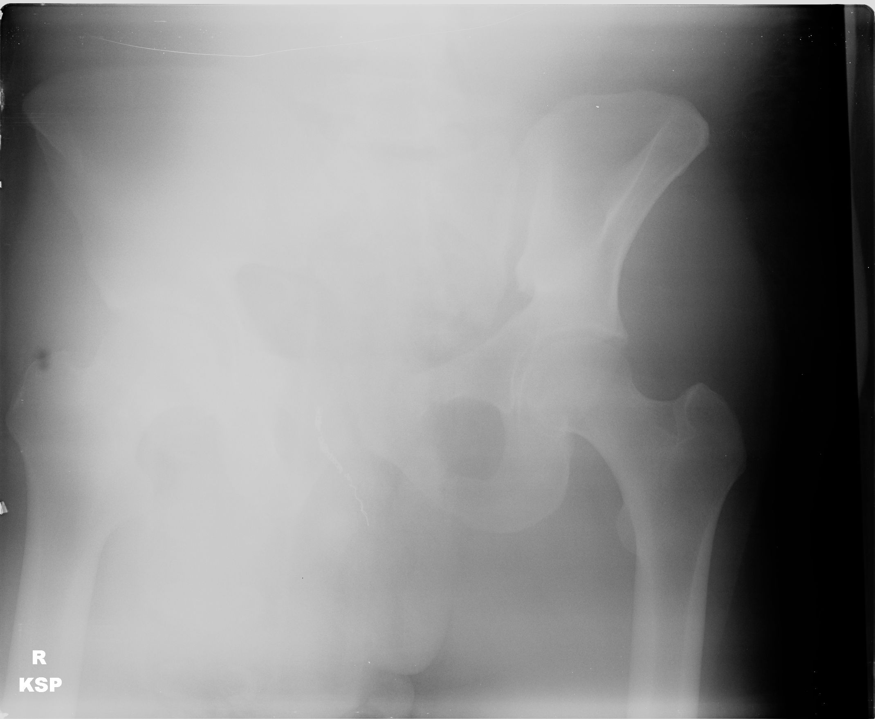

Slide 6
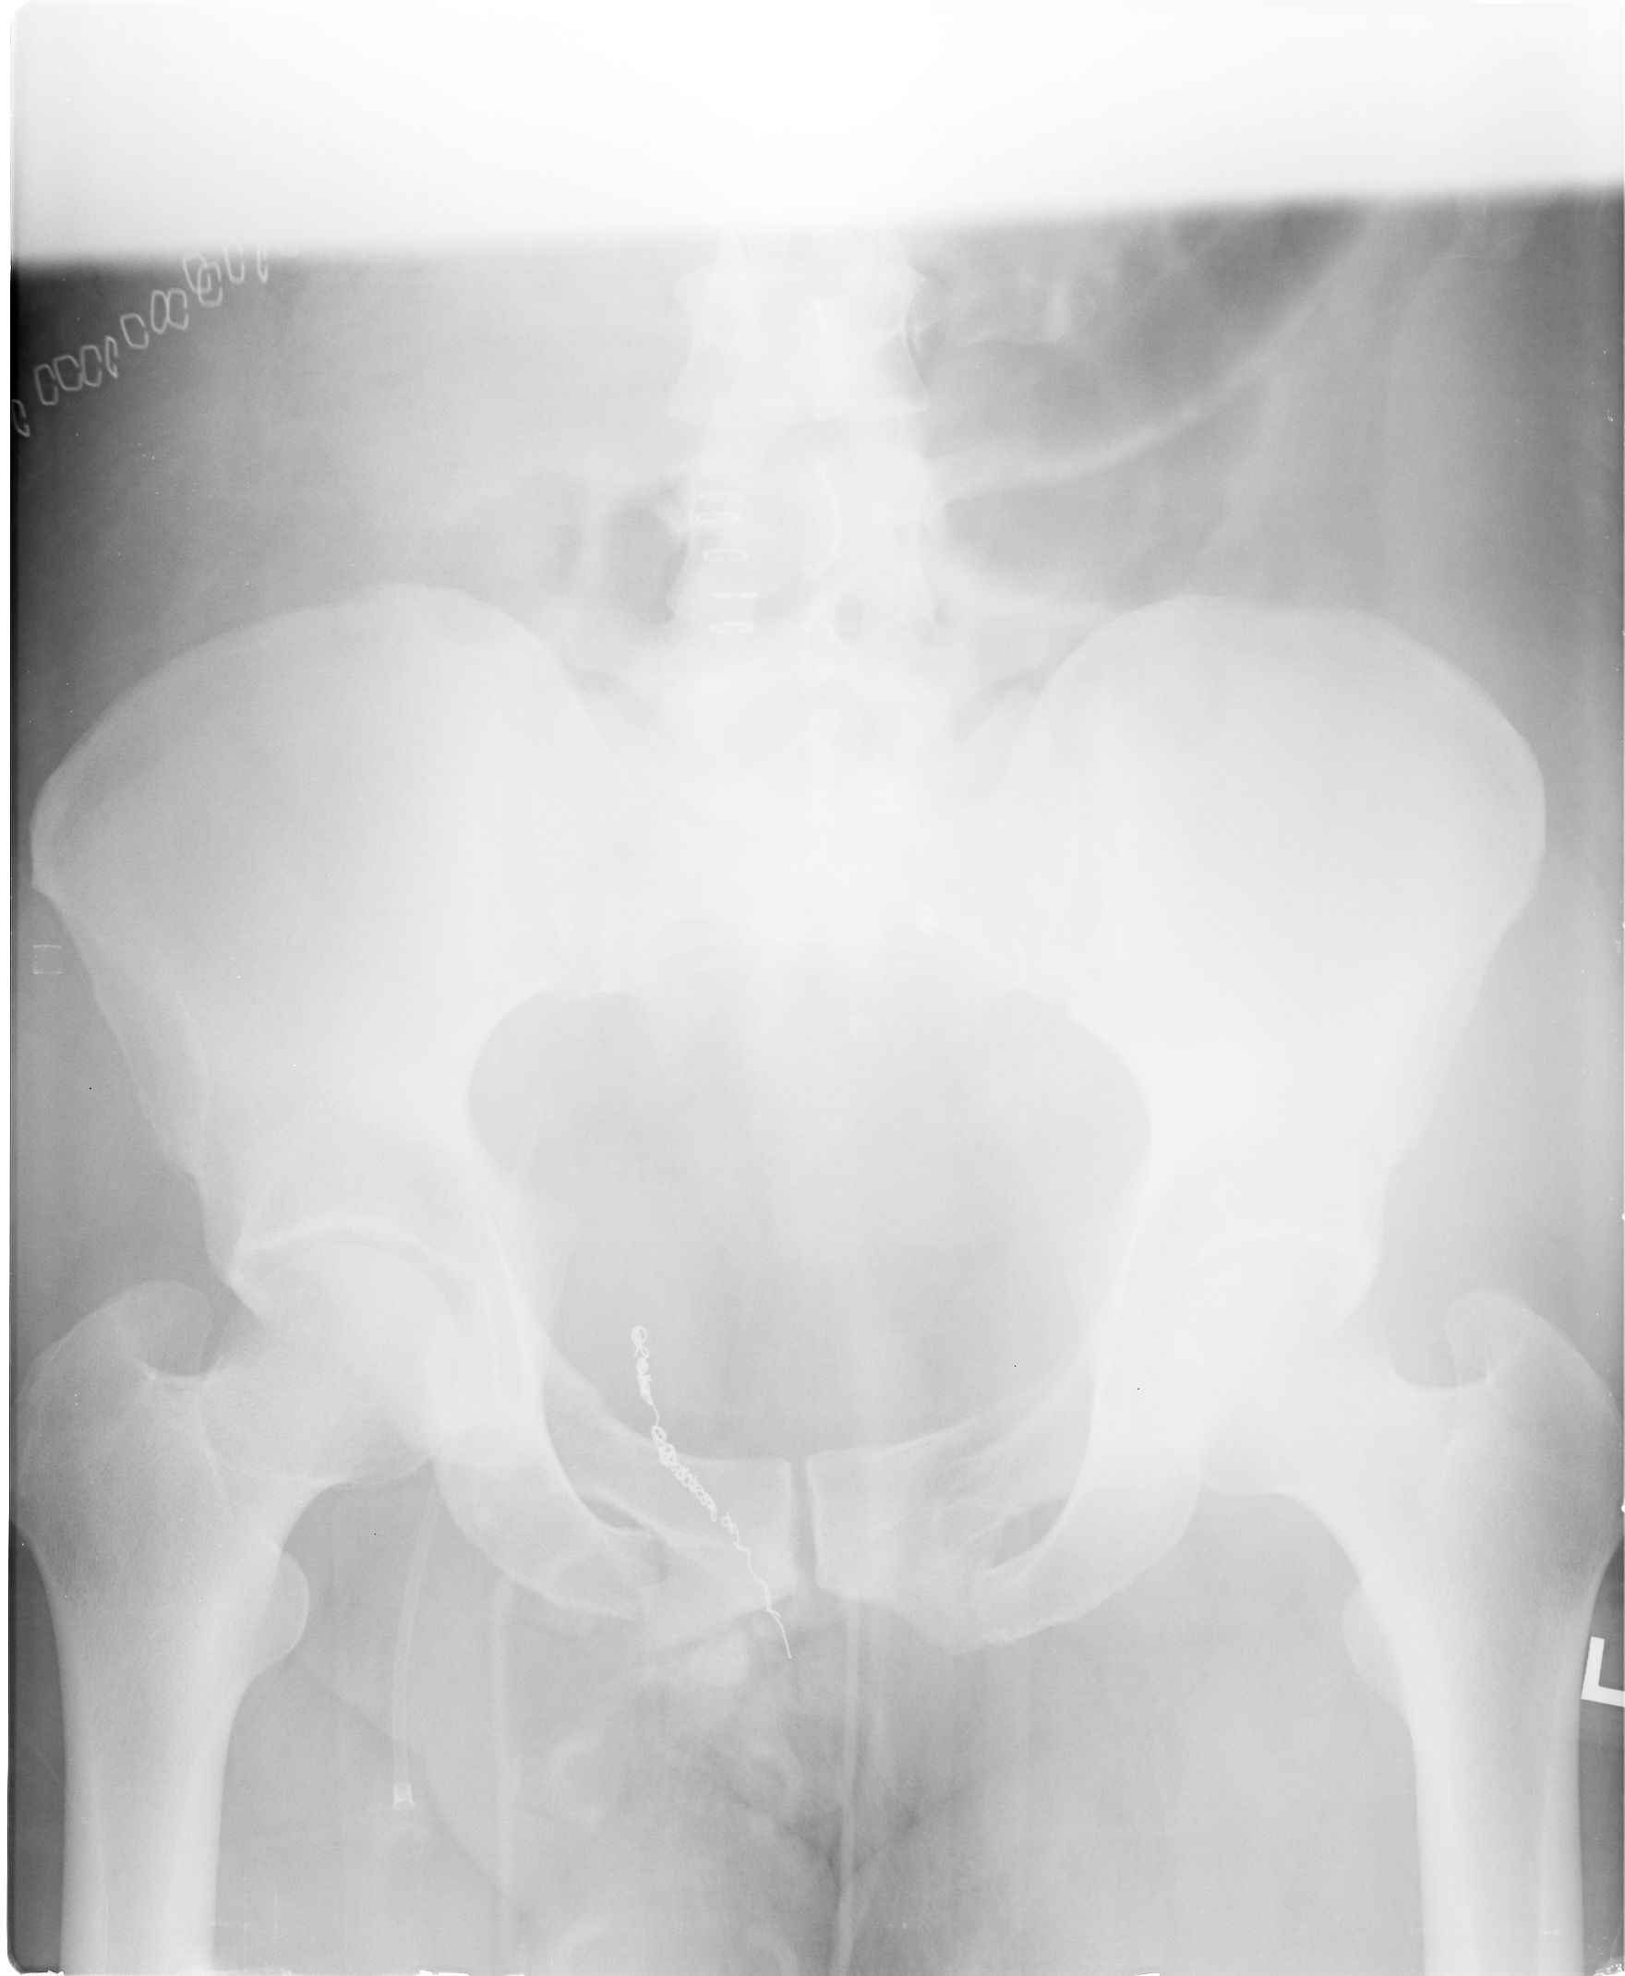

Slide 7
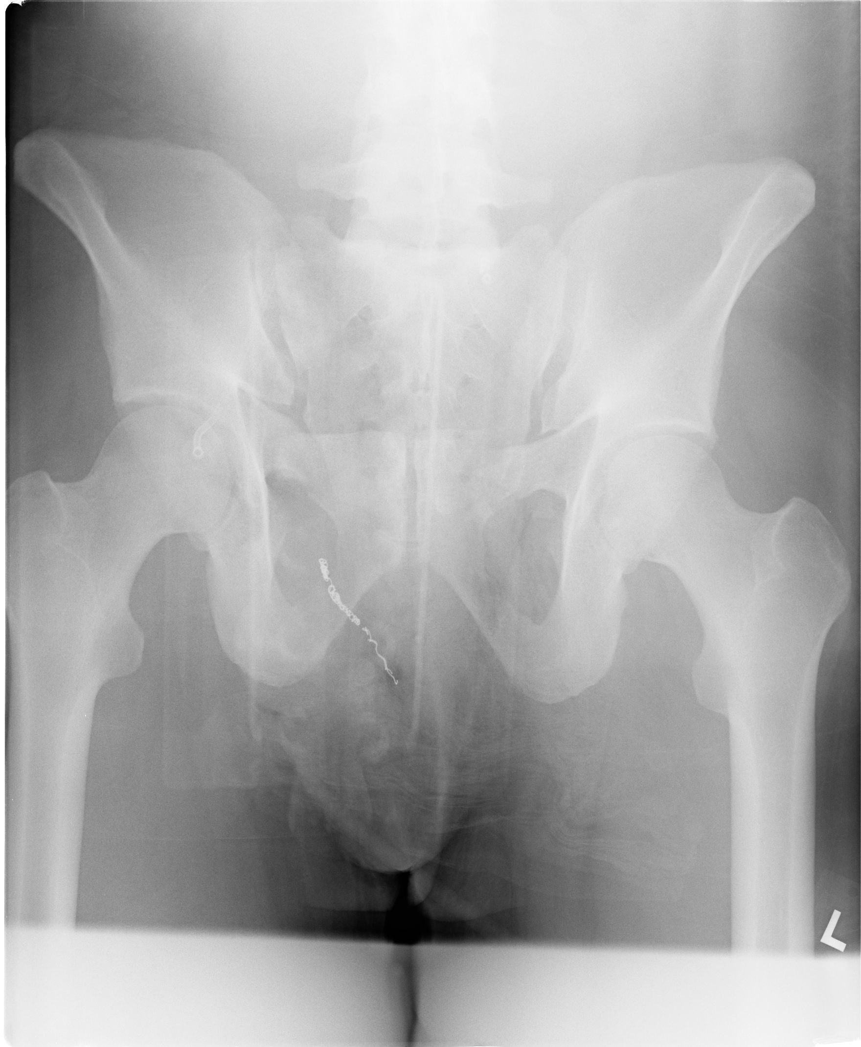

Slide 8
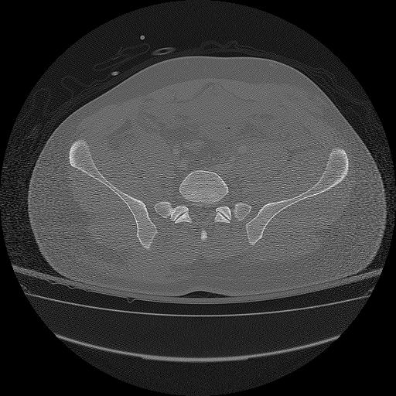

Slide 9
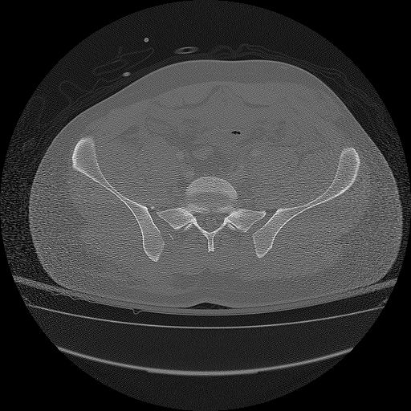

Slide 10
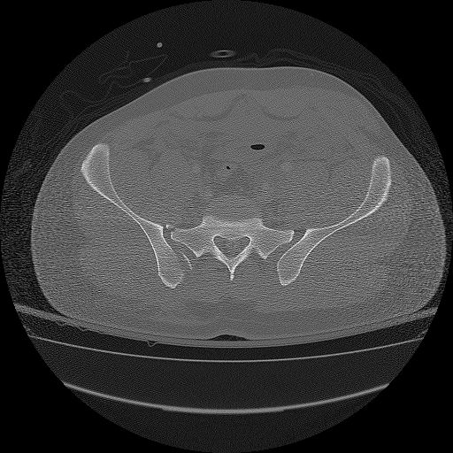

Slide 11
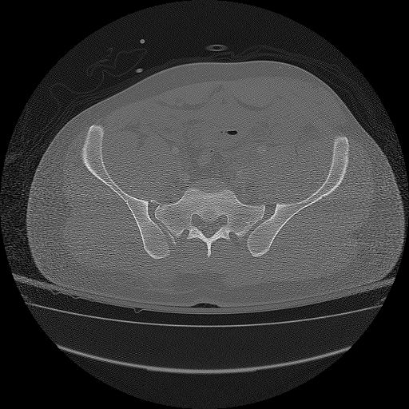

Slide 12


Slide 13
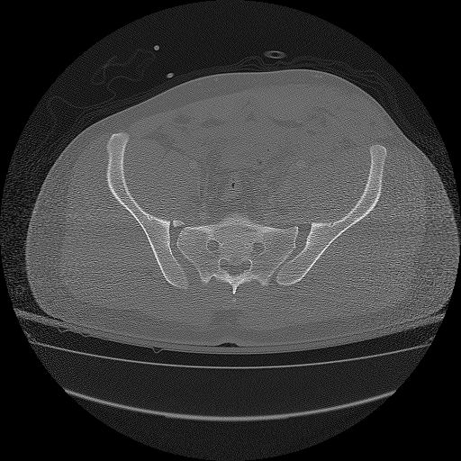

Slide 14
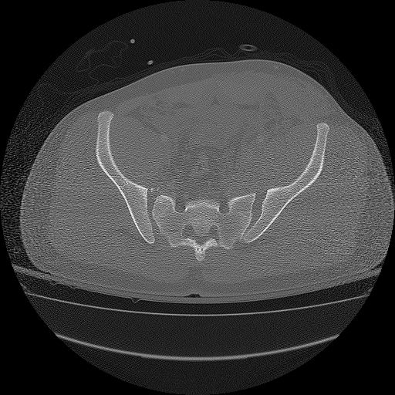

Slide 15


Slide 16
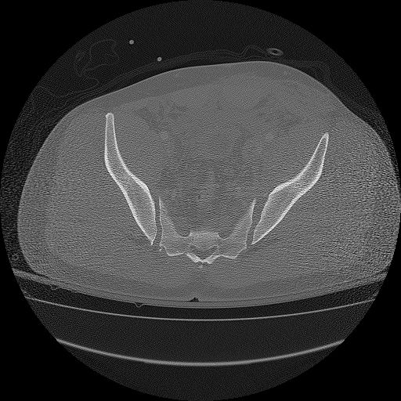

Slide 17
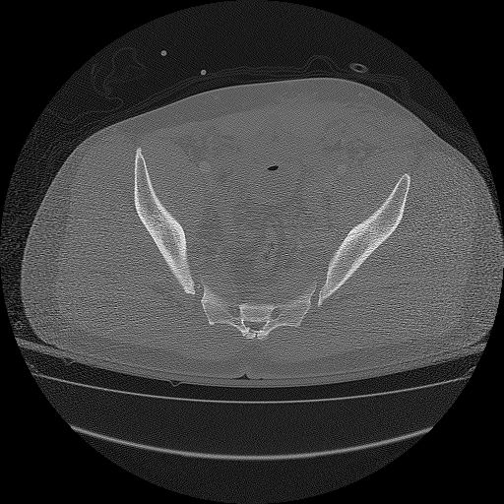

Slide 18
Fracture Pattern
Appears to be an LC 3
R hemipelvis appears to have rolled in.
Portion of R ala is impacted
Triangle of bone knocked off R ala at level of impaction
Small crescent from posterior portion of R ilium left in place
L SI joint appears widened anteriorly

Slide 19
SICU Course
Patient stabilized hemodynamically
Binder removed – no traction
Taken to OR for pelvic fx repair 6 days after admission

Slide 20
Operating Room
Fluoro reveals worsened displacement of both sides of posterior pelvic ring.

Slide 21
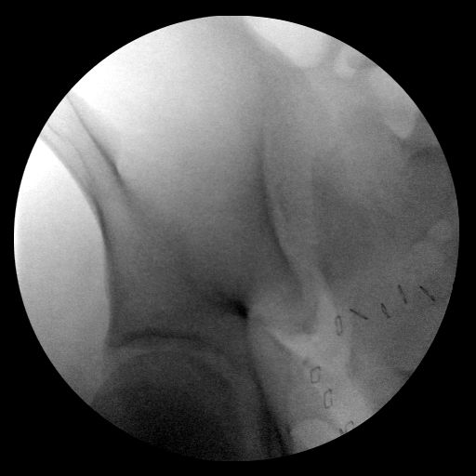
R SI joint is wide…and up…

Slide 22
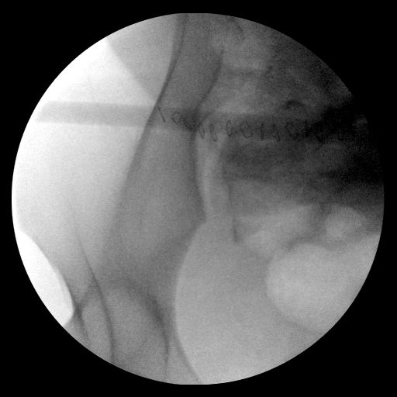
…and back.

Slide 23
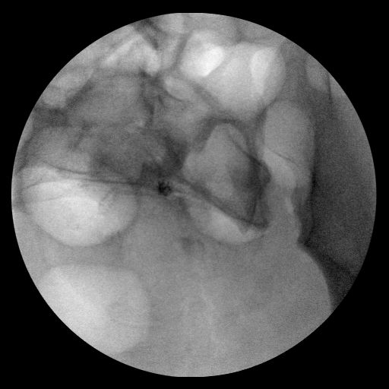
L SI joint is wide…

Slide 24
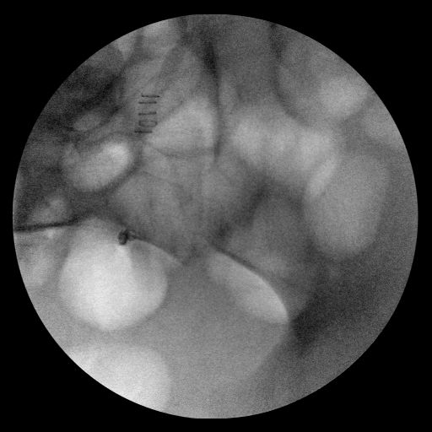
…and back…

Slide 25
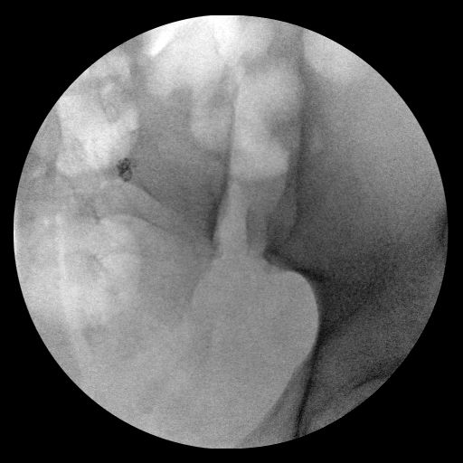
…but not up.

Slide 26
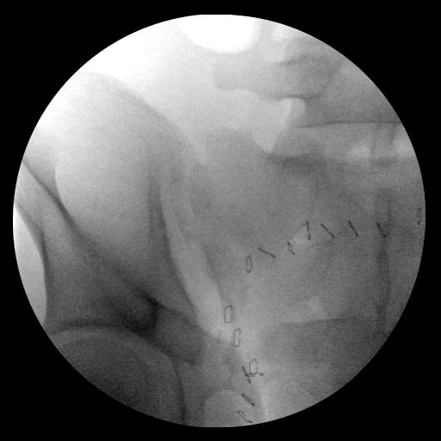
R leg skeletal traction

Slide 27
Traction on R leg
Improved cephalad displacement some
Didn’t affect R SI gap
R ilium anchored to pelvic reduction frame

Slide 28
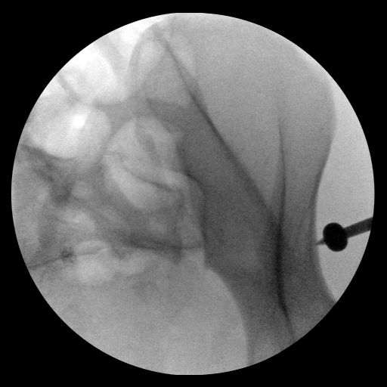
L side – kugelspitz with motor attached to frame to improve L SI widening

Slide 29
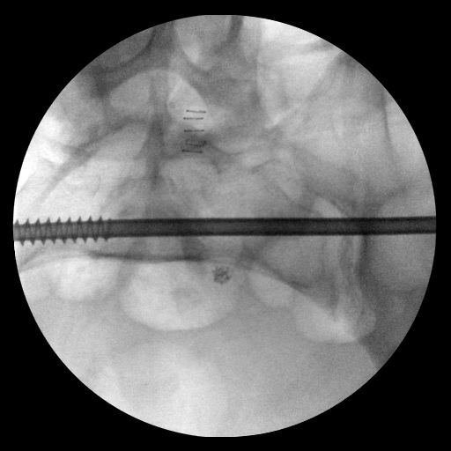
L iliosacral screw used to compress L SI joint further

Slide 30
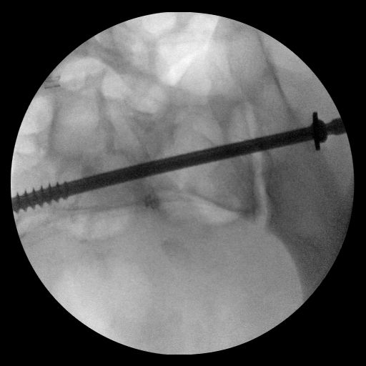

Slide 31
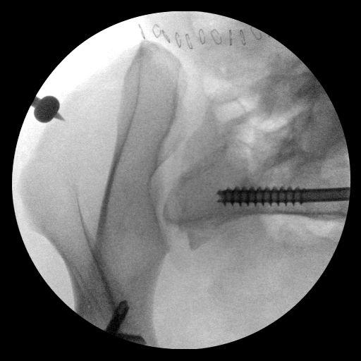
Stabilized L side now anchored to frame. Pins placed in R AIIS, used to pull R ilium forward

Slide 32
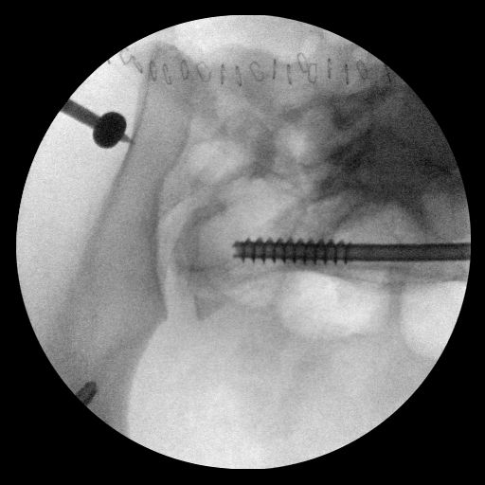
Kugelspitz used to rotate R ilium externally and close gap of R SI joint

Slide 33
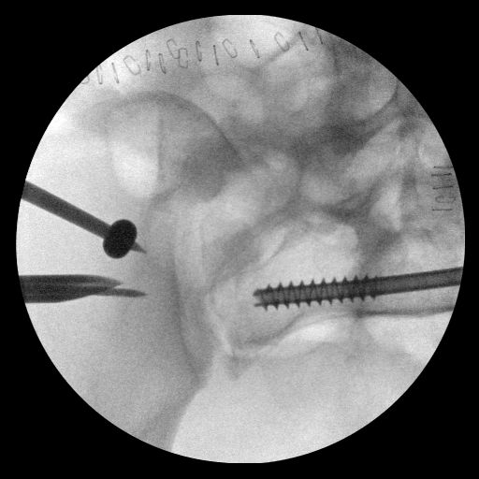
R sided iliosacral screw placed

Slide 34
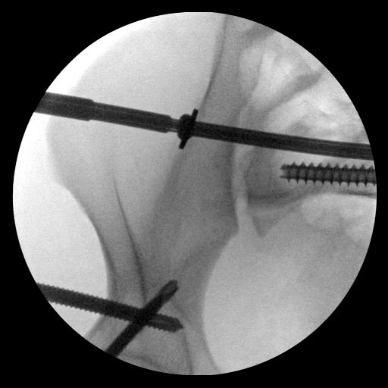

Slide 35
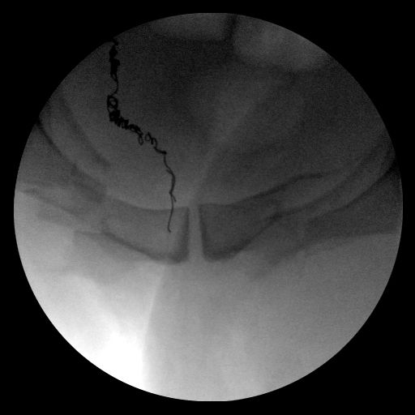
Anterior ring. Alignment acceptable. Markedly bruised, edematous.

Slide 36
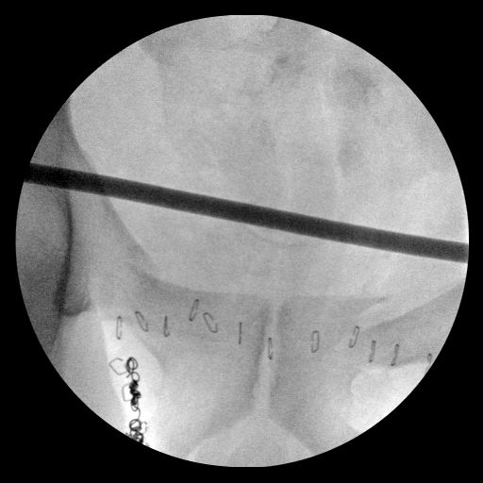
Infix bar placed

Slide 37
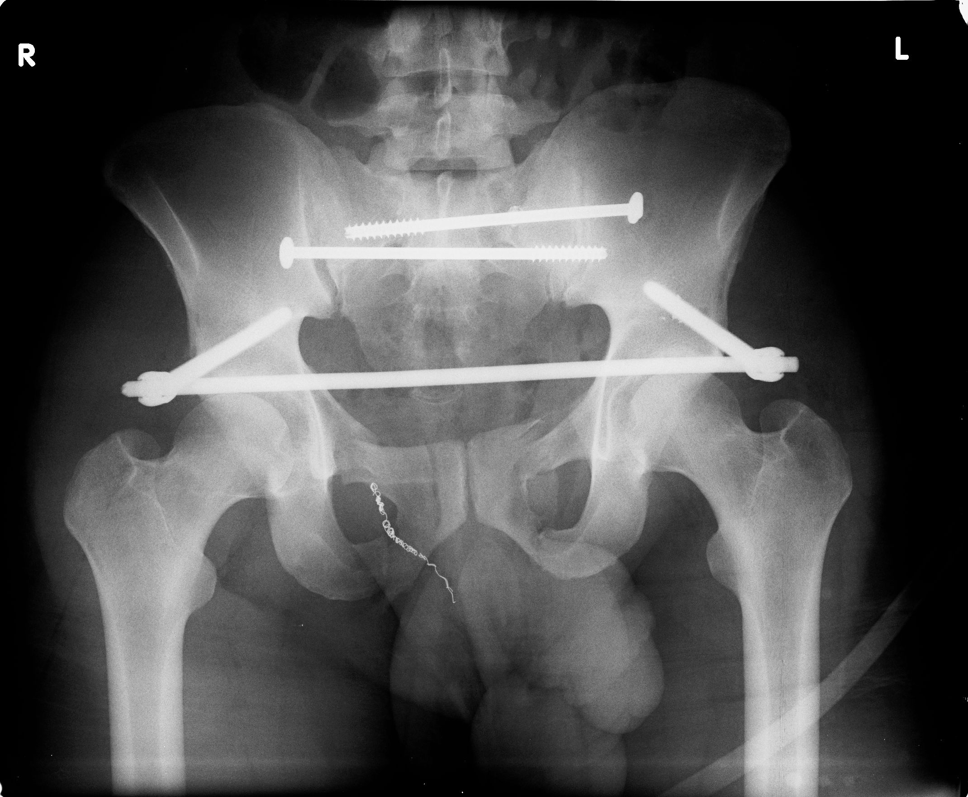

Slide 38
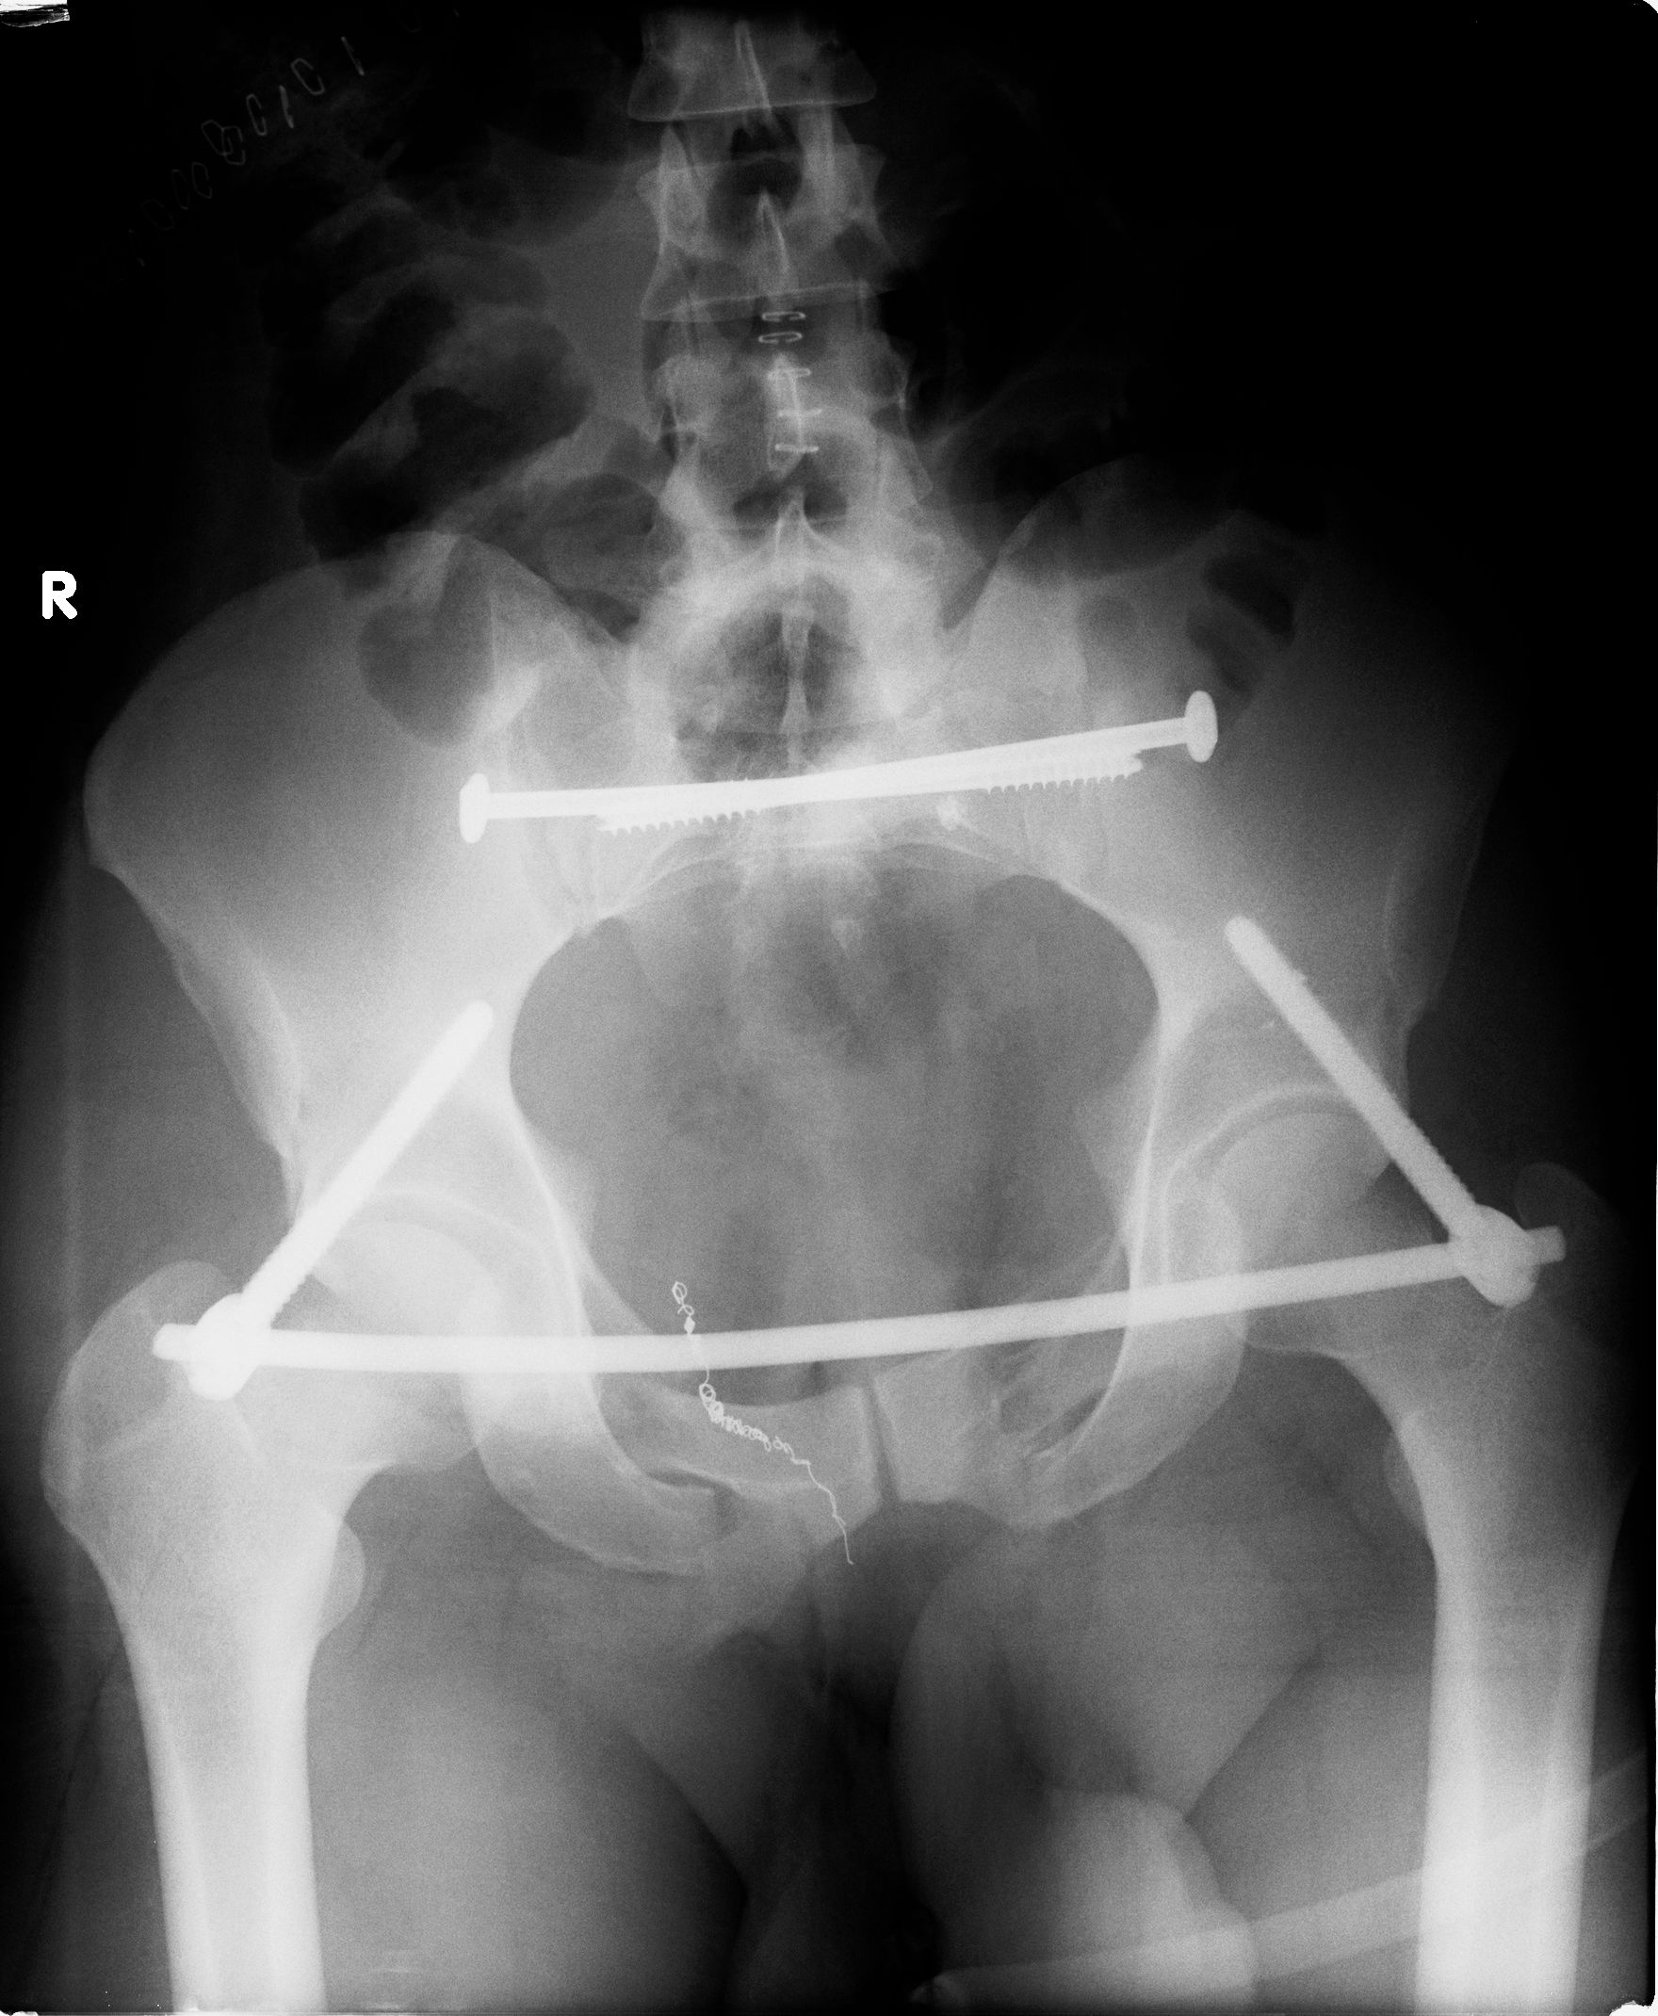

Slide 39
