Slide 1
Case Index Number:
001
Posted by: | Injury | Fixation
Adam Starr, M.D. Parkland Hospital Dallas, TX | Bilateral sacral fracture with contralateral SI disruption; Symphysis disruption; Iliac wing fracture | IS screws; LC-2 screw; Ex-fix

Slide 2
Pelvic Fracture
54 year old male
Dropped off at ER by private car – no history
Presumed MPC
Hemodynamically unstable on arrival
GCS = 10

Slide 3
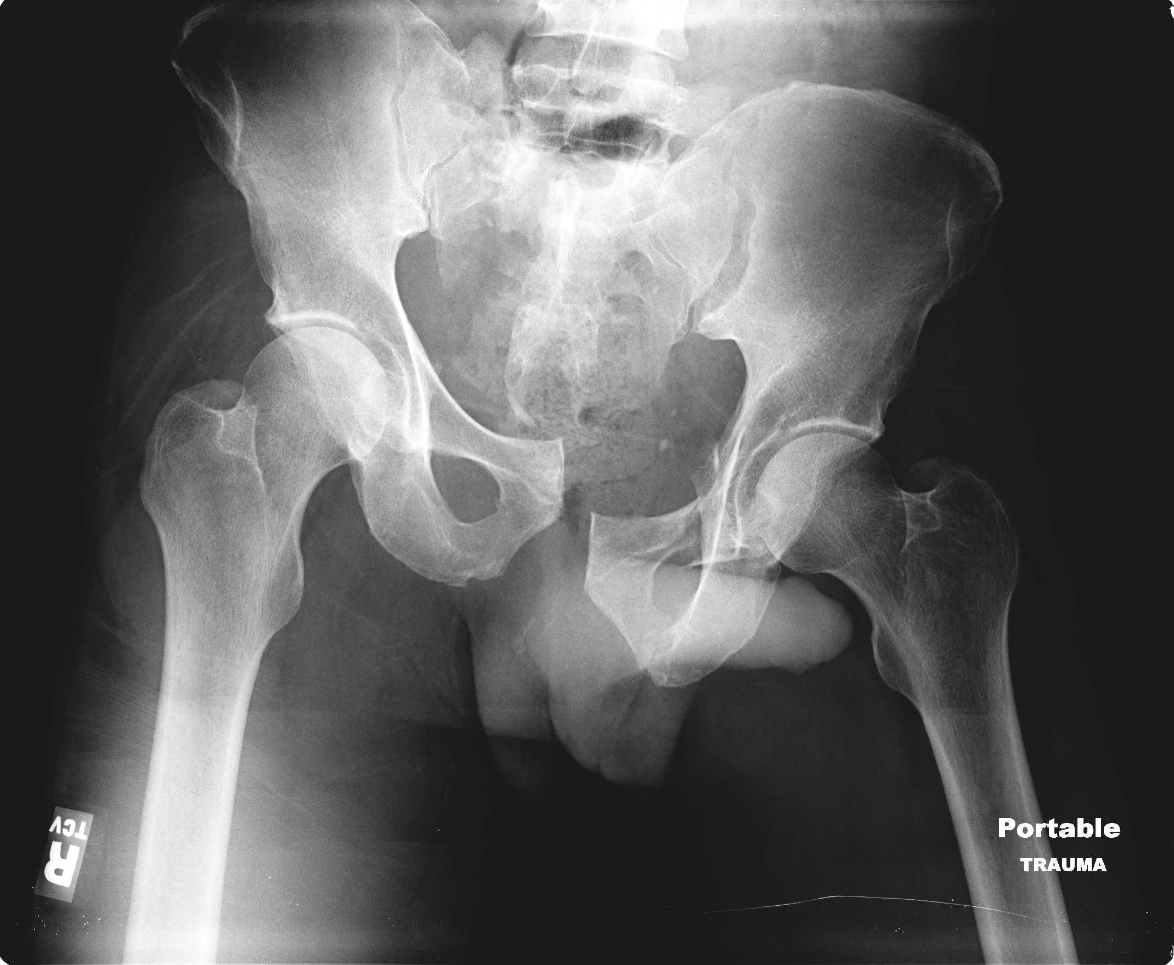

Slide 4
Pelvic Fracture
Resuscitation
  Lactated Ringer’s – 2L
  Transfusion with PRBCs begun
Pelvic binder placed.
Remains hypotensive.

Slide 5
Pelvic Fracture
Exploratory celiotomy
  No solid organ injury
  Retroperitoneal hematoma
  Abdomen packed open
Anterior pelvic external fixator placed

Slide 6
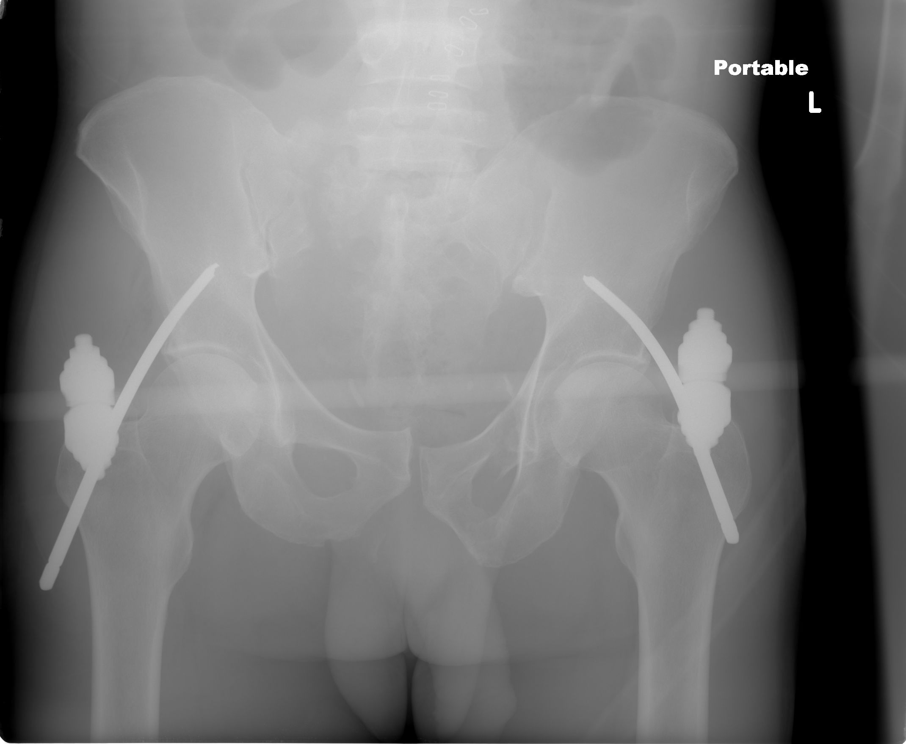

Slide 7
Pelvic Fracture
Remains hemodynamically unstable
Pelvic angiography
  R internal iliac artery embolized
Hemodynamically improved
To SICU

Slide 8
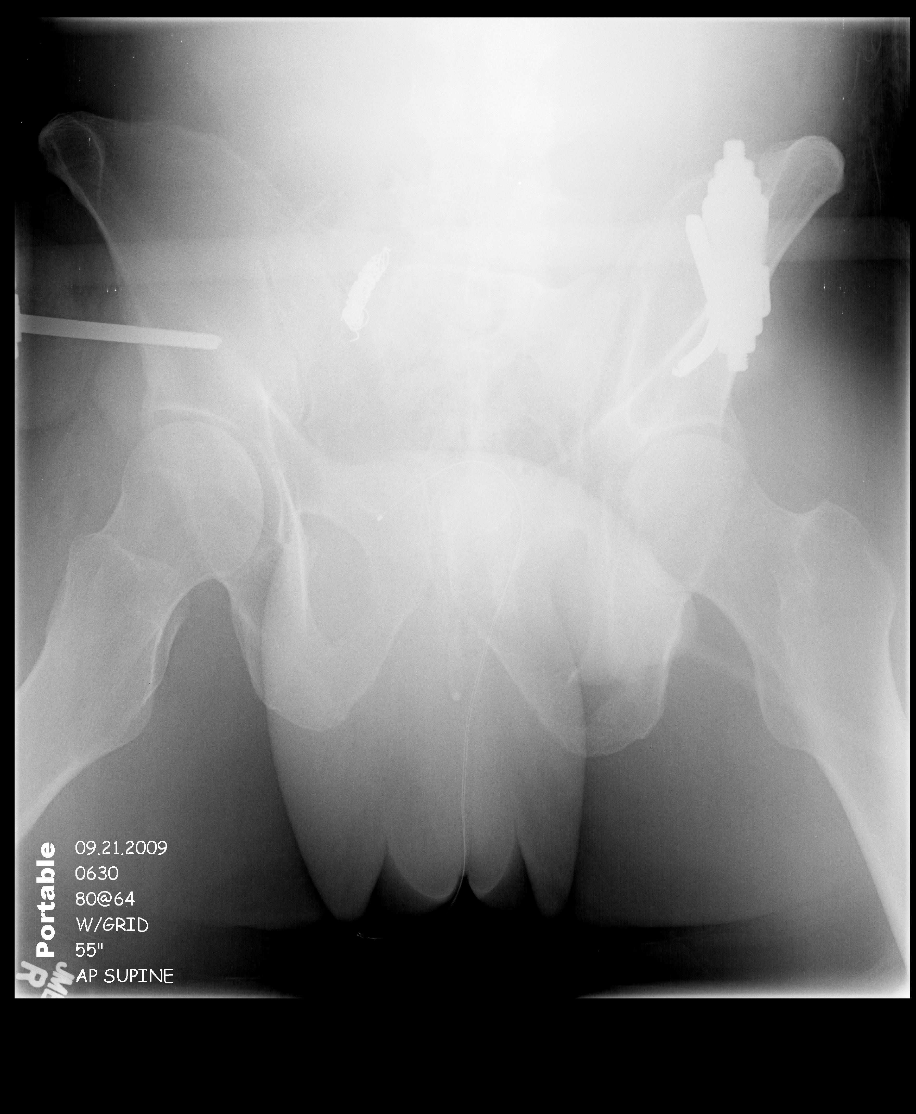

Slide 9
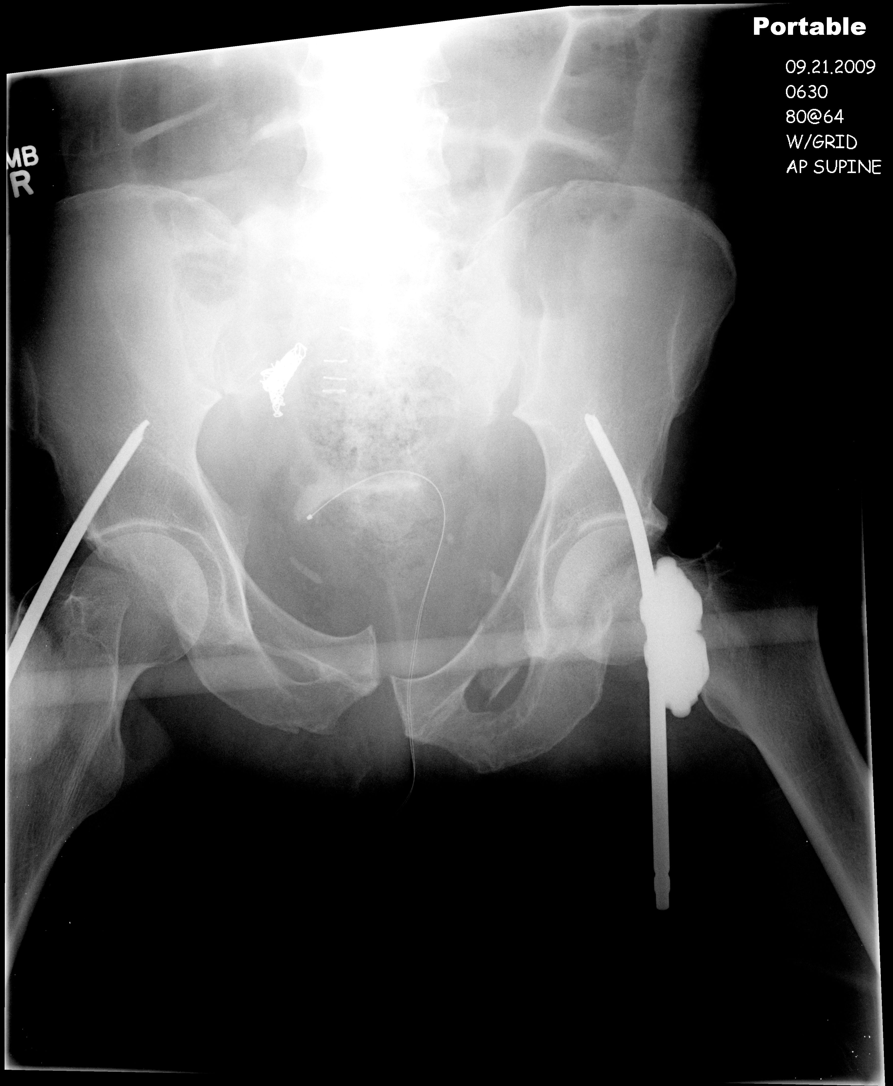

Slide 10
Pelvic Fracture
Stabilizes in SICU
Family gives history of alcohol abuse, Hep C

Slide 11
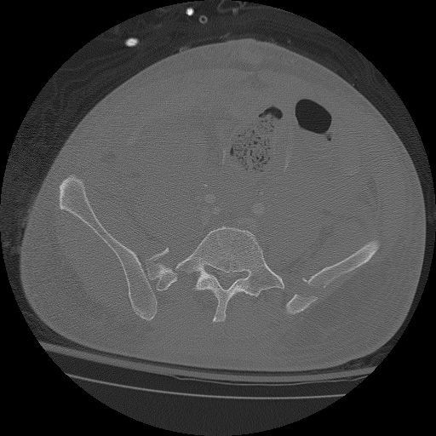

Slide 12
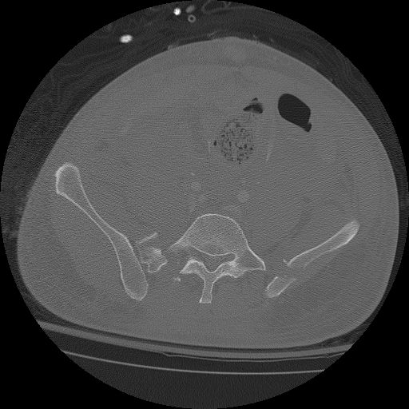

Slide 13


Slide 14


Slide 15
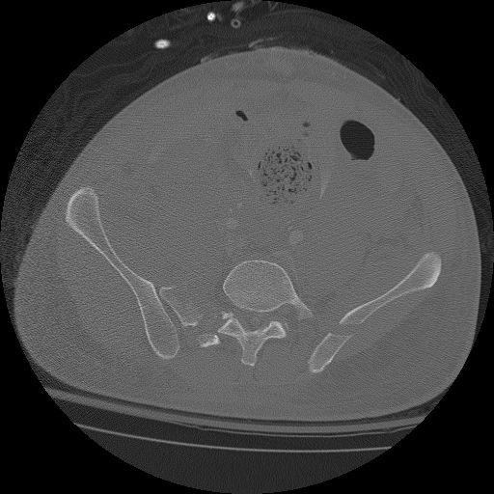

Slide 16


Slide 17
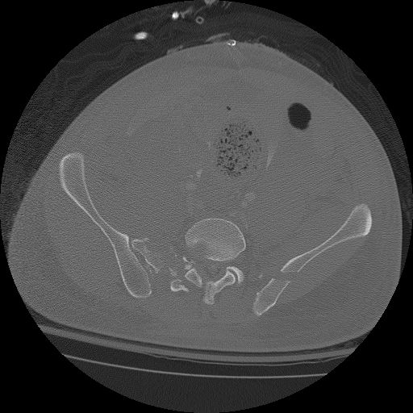

Slide 18
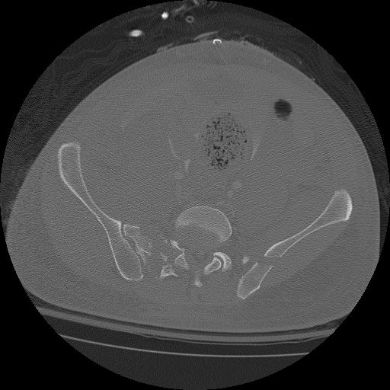

Slide 19


Slide 20


Slide 21


Slide 22
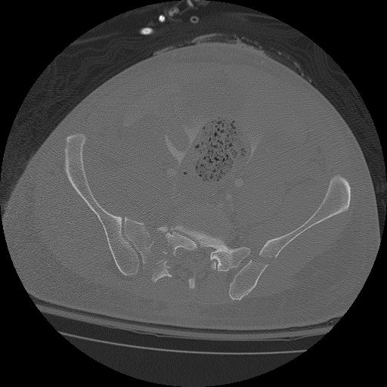

Slide 23
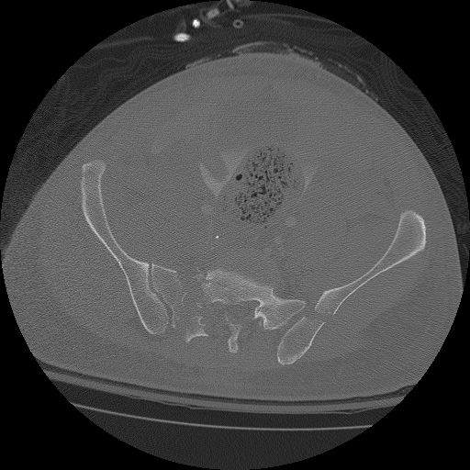

Slide 24
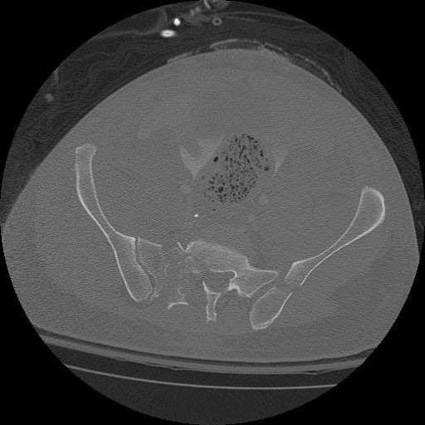

Slide 27


Slide 28
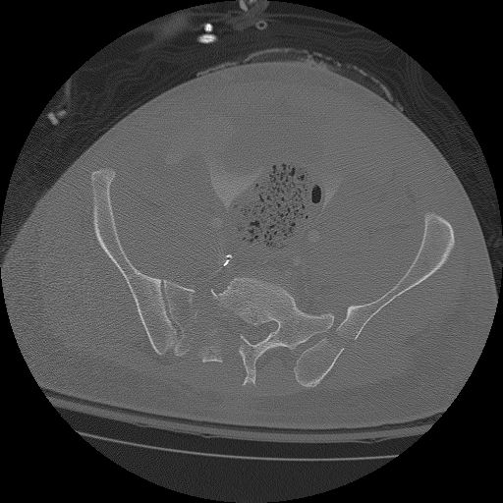

Slide 29


Slide 30
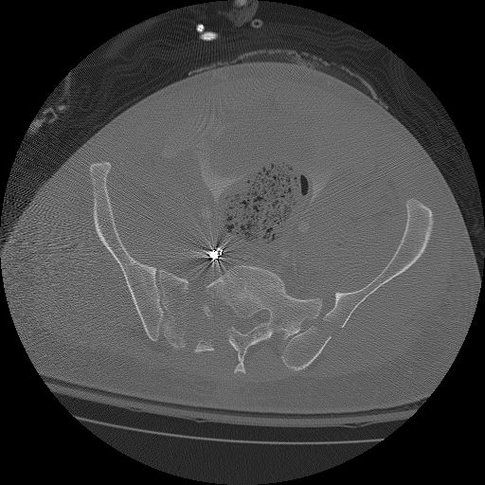

Slide 31
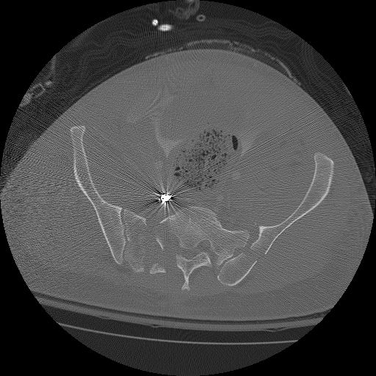

Slide 32
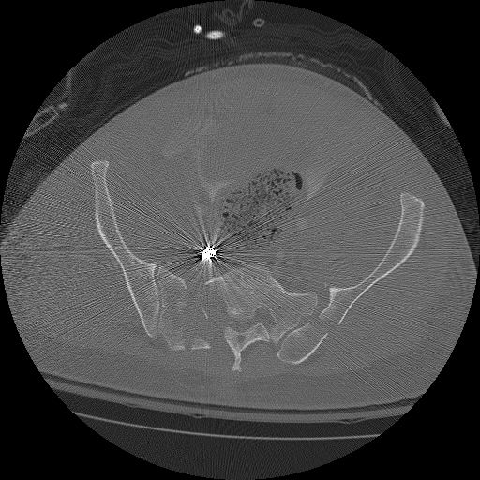

Slide 33
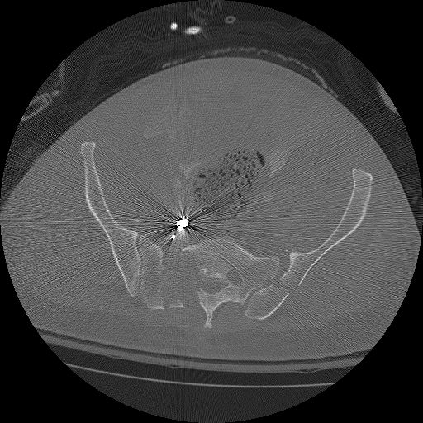

Slide 34
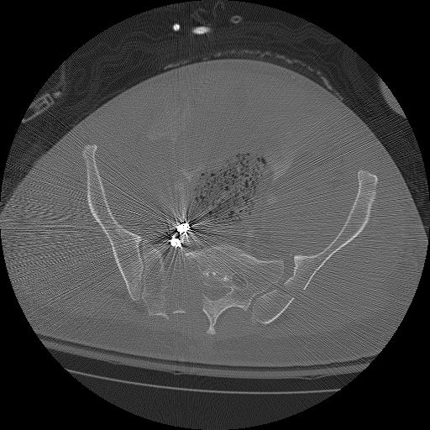

Slide 35


Slide 36
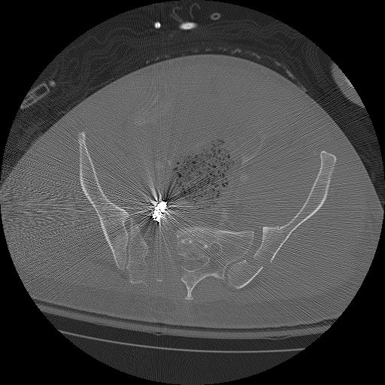

Slide 37
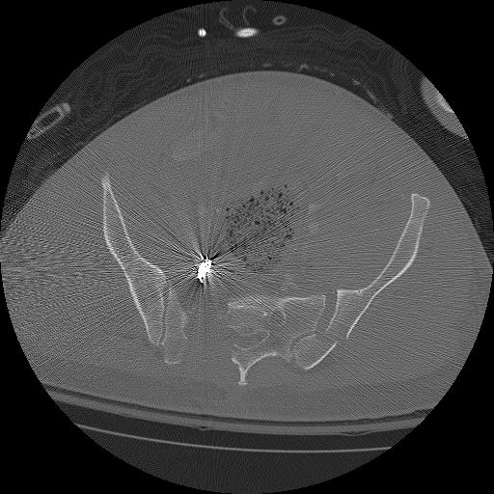

Slide 38
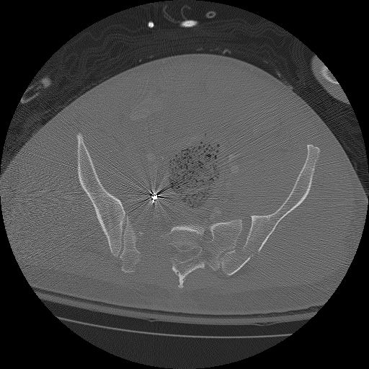

Slide 41
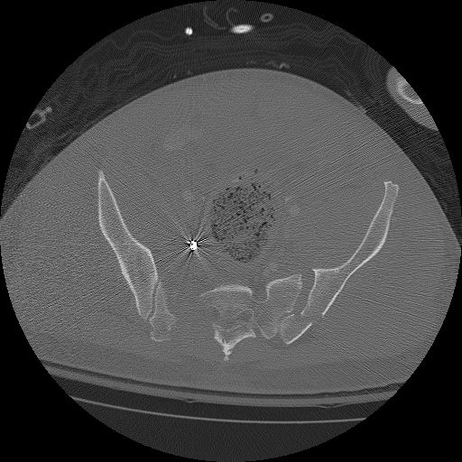

Slide 42


Slide 43
Pelvic Fracture
Taken for pelvic fracture repair on 5th day.
Still intubated in SICU.
Abdomen still open.

Slide 44
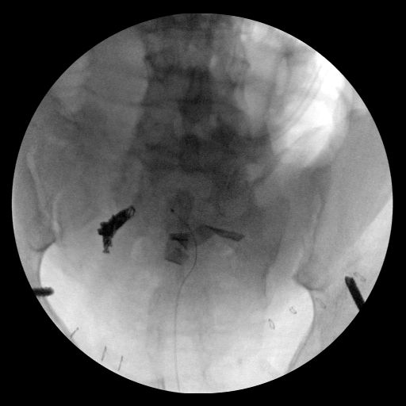

Slide 45
Pelvic Fracture
L hemipelvis displaced cephalad.
R hemipelvis – still un-reduced - anchored to frame using 2 pins to allow independent mobilization of L hemipelvis.
Traction used to improve alignment.
  Crescent fracture alignment at iliac crest and lower SI joint used to assess reduction
  Ball spike pusher used to reduce lateral displacement of anterior portion of ilium, anterior to crescent fragment.
Once L hemipelvis reduced, stabilized with L S1 iliosacral screw and L LC 2 screw.

Slide 46
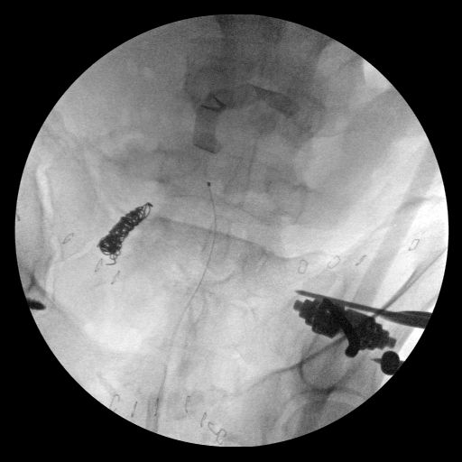

Slide 47
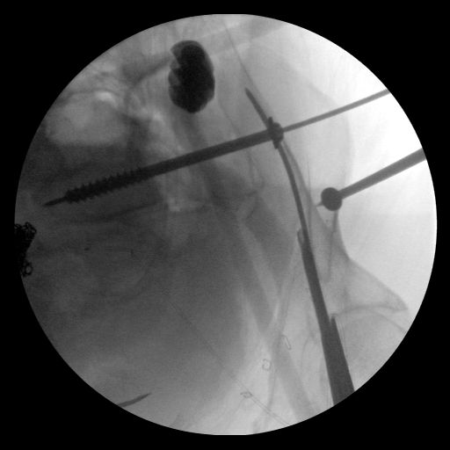

Slide 48
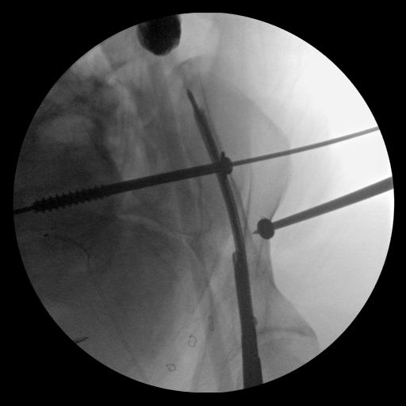

Slide 49
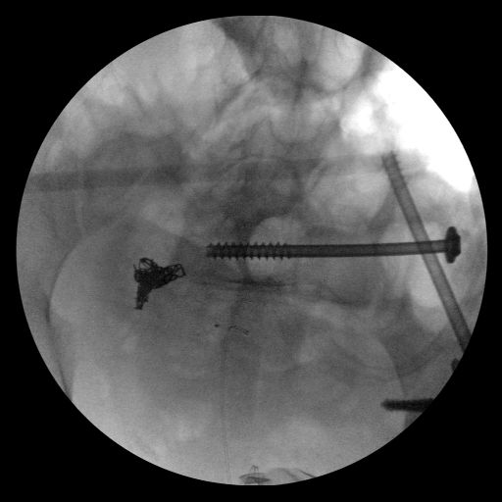

Slide 50
Pelvic Fracture
R hemipelvis displaced posteriorly and cephalad.
Reduced L hemipelvis anchored to frame to allow independent movement of R side.
  R hemipelvis manipulated via skeletal traction through R leg and manipulation of AIIS ex fix pin placed previously.

Slide 51
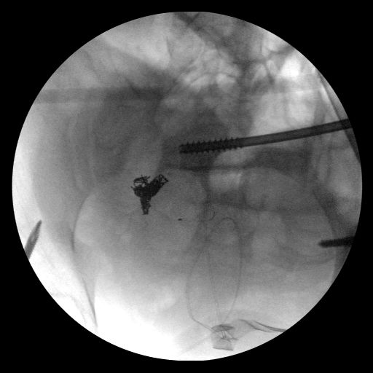

Slide 52
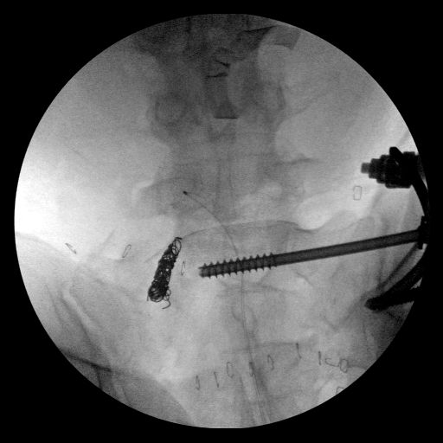

Slide 53
Pelvic Fracture
R sided ala still slightly elevated.
Minor increase in amount of longitudinal traction improves alignment.
R sacral fracture stabilized with iliosacral screw.

Slide 54
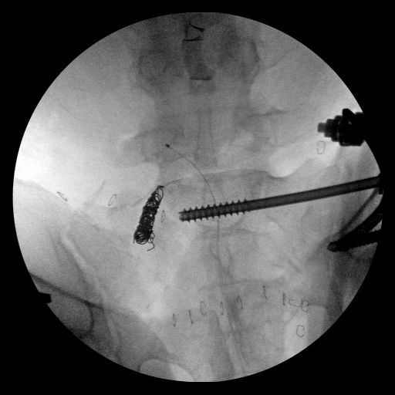

Slide 55
Pelvic Fracture
Symphyseal alignment now acceptable.
Anterior ex fix frame used for anterior stabilization.

Slide 56
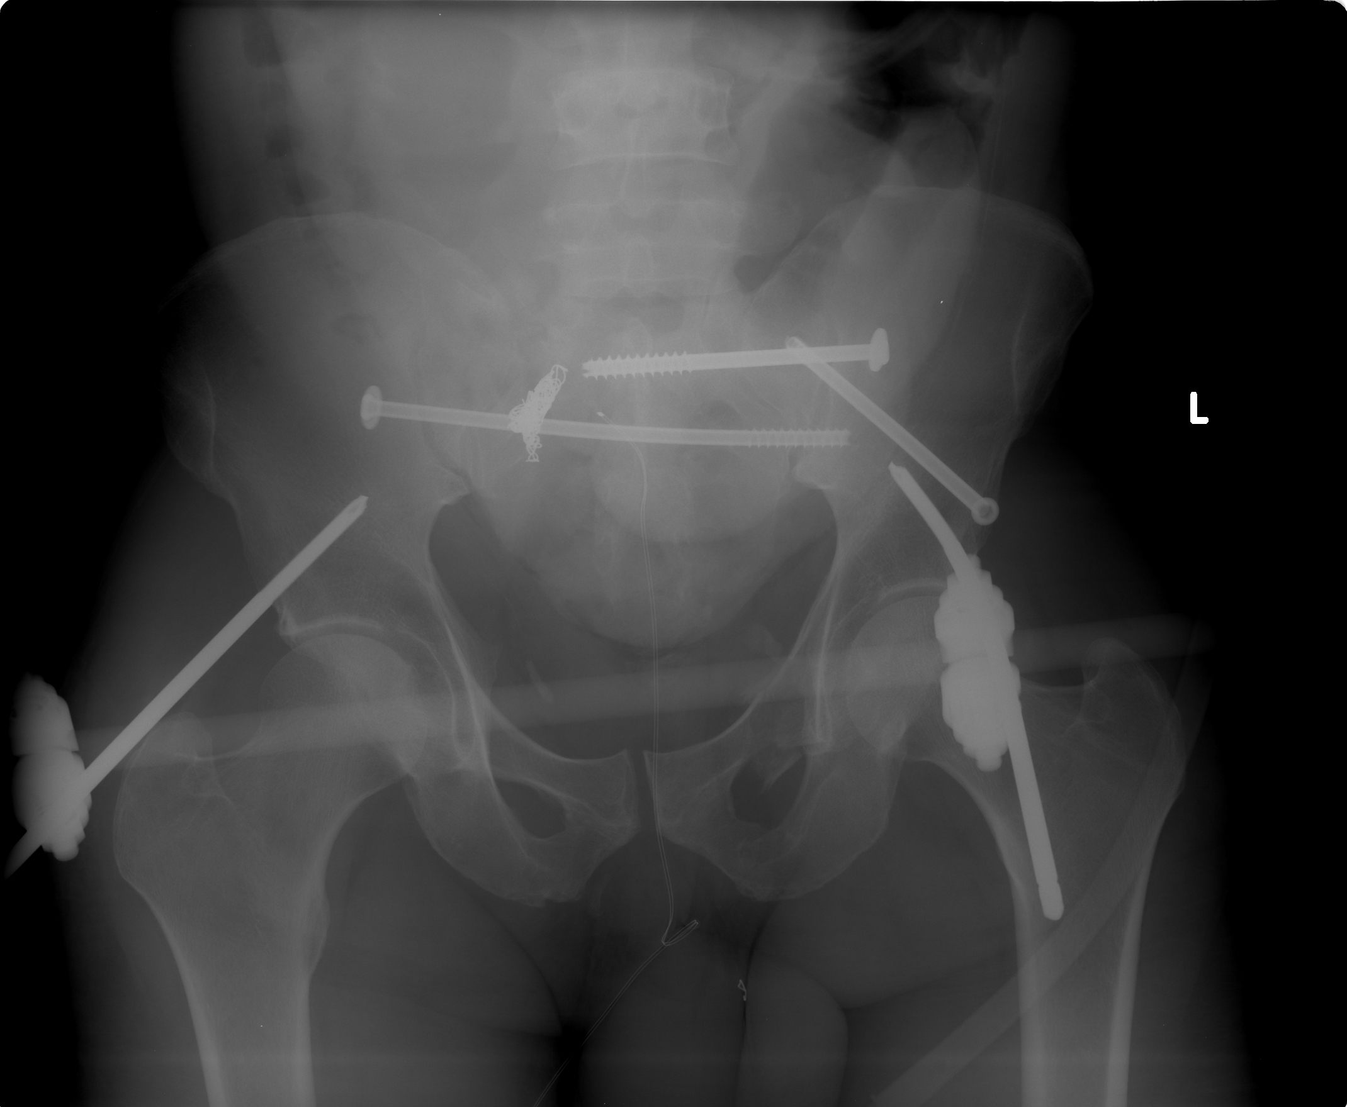

Slide 58
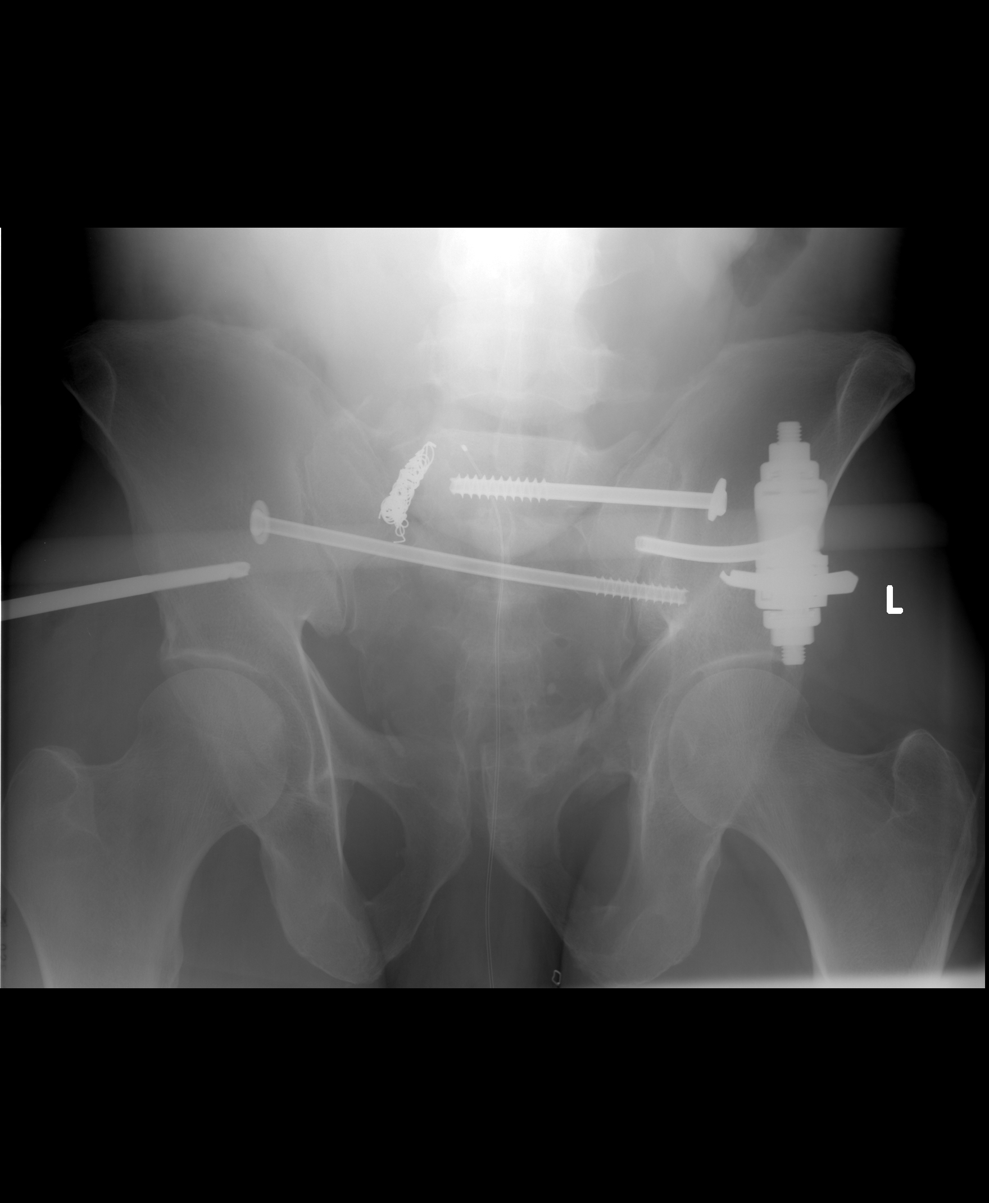

Slide 60
